Slide 1
Building Prediction Models for House Prices
Arya Sukarno(U42813741)
Ashley Richard (U82939847)
Ethan Freshman (U63289110)
James Rahman (U13313207)
Jonathan Yung (U28856227)
Notes:
Ashley

Slide 2
Data Source
Source
Types
Shape
Data Integrity
Depicts the characteristics of homes sold in Ames, Iowa
Categorical Variables: 48
Main Data:
Sale Price
Numerical Variables: 33
Columns: 81
Time Frame: 2006 - 2010
Row: 1460

Slide 3
Data Cleaning
Methodology
Reason
Reason
Took out variables that we deemed irrelevant and have a low correlation to the sale price
Ex. roof tile, wood decks, and Fence
Due to the high number of variables (81), we removed 41 columns in order to narrow down the entire dataset.
Removed one row to make data easier to work with
(only 1 house has 5 car garage)
Notes:
We used our intuition ro remove variables since there were 81 variables and it would take way too long to test all of them

Slide 4
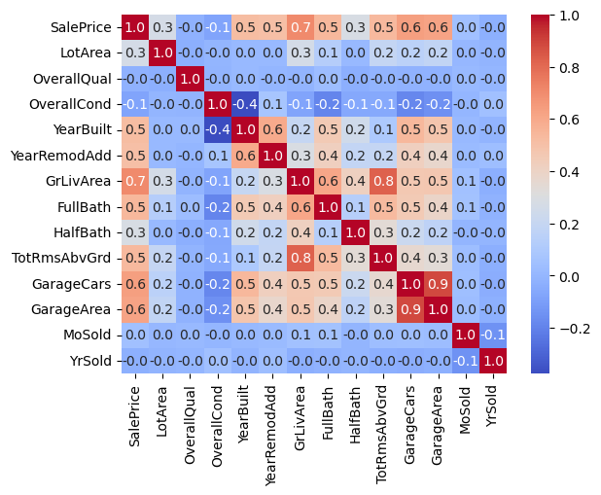
Relation - Correlation Matrix
Correlation with all
numerical variables
All positive correlation values
Lot Area is weak
Above Ground Area
is strongest
Garage Cars/Area
notably moderate

Slide 5
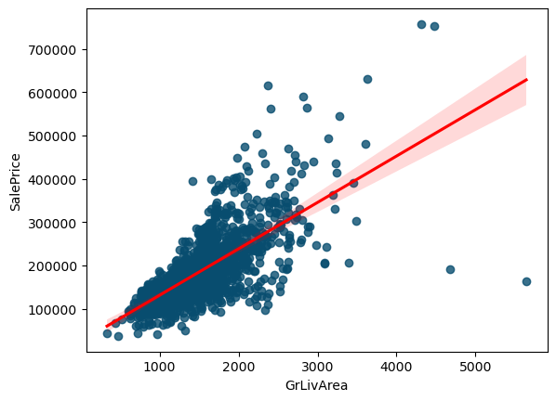
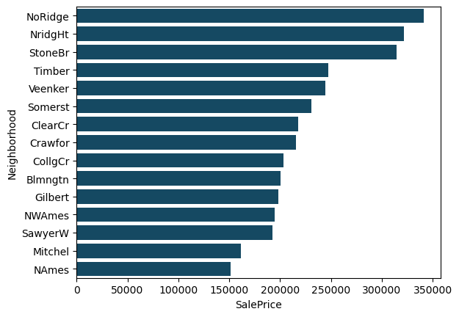
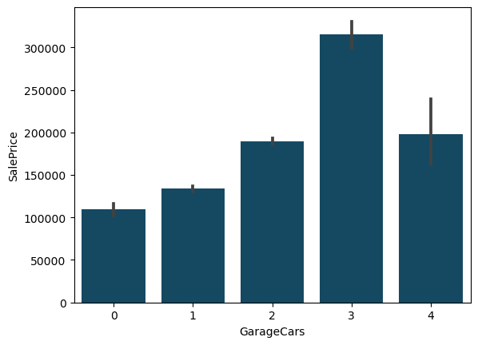
Relation - Notable Variables
Adj. R-Sq: 0.543
Adj. R-Sq: 0.502
Adj. R-Sq = 0.490
P-Value: Varies
P-Value: 0.00
P-Value: All <= 0.01

Slide 6
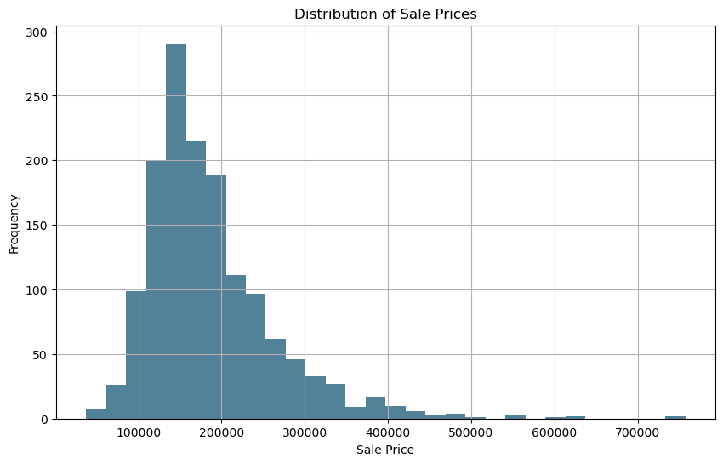
Sale Price Distribution
Mean: $186,440
Median: $167,847
Standard Deviation:
$79,441
The distribution of Sale price is not a normal distribution.
Skewed right
Unimodal and Asymmetric
Notes:
Ashley
The mean, or average, is greater than the median.

Slide 7
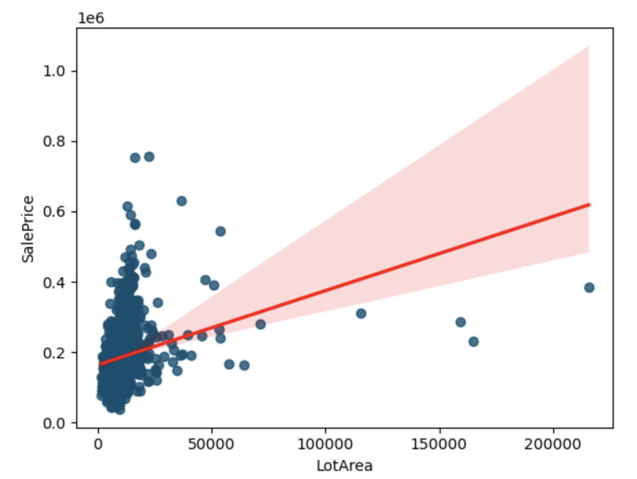
Causal Analysis - Linear Regression
Lot Area to Sale Price
Adjusted R-Squared: .07
y = 0.000016 + 2.11(Lot Area)
Each unit increase in lot area should raise price by $2.11
Lot area shows little predictive power on its own
Graph
Notes:
Ethan

Slide 8
Causal Analysis - Multiple Regression
Forward Model
To make our Forward Multivariate model more accurate in predicting lot area to sale price, we made a function that filters R-Squared of all the variables. If the R-squared was larger than .4, we added the variable into our regression model.
Adjust R-Squared: .825
SalePrice ~ LotArea + GrLivArea + GarageCars + Neighborhood + ExterQual + KitchenQual Electrical + HeatingQC + HouseStyle + Utilities + Alley + Street + MSSubClass + MSZoning
Notes:
Jonathan
We made a function that filters the R^2 of all the variables. If the R^2 was larger than 0.4, we added the variable into the model.

Slide 9
Causal Analysis - Multiple Regression
Backward Model
This final multiple regression model we used has taken out irrelevant variables, which we tested in our prototype model. The variables with a high P-value (> .05), were taken out of the equation in order to increase accuracy.
Adjust R-Squared: .811
These variables were removed due to the lack of correlation to lot size:
Electrical + HeatingQC + HouseStyle + Utilities + Alley + Street + MSSubClass + MSZoning
SalePrice ~ LotArea + GrLivArea + GarageCars + Neighborhood + ExterQual + KitchenQual
Notes:
Jonathan
For the categorical variables, the variables without a dummy variable that has a p-value less than 0.05 is deleted because they are not statistically significant
Although the adj r-squared is lower, the variables removed were not statistically significant, meaning that the model is technically more accurate, although it would be lower as we took
We tried to remove any more but the adj r-squared kept decreasing to 0.7, much lower than our initial resutls

Slide 10
Prediction - Process
Clean up unused variables.
Removed the outlier with a 5 car garage.
Used previous model to predict newSalesPrice.
Assign new variable to the dataframe to be processed.
Notes:
Arya
From the model that my colleague Jon provided, we are able to create a model that is able to predict sale price from the dataset houseprices_test.
We took a similar approach where we firstly cleaned up the dataset, and used .predict to create a list of newSalesPrices, and assign those new Sale Prices to a variable in the dataframe to be processed.

Slide 11
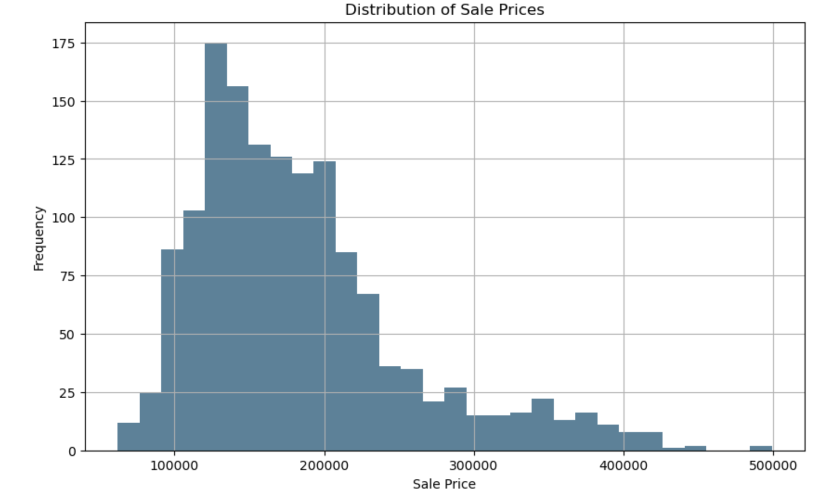
Prediction - Test Data Results
Mean: $183,648
Median: $168,850
Standard Deviation:
$72,249.62
Adj R-Squared: 0.825
Notes:
Arya
Since we can see that the mean is greater than the median, the data from the prediction model is also right skewed and unimodal.
From these results, the median is not the same as the mean, despite not being far off. This means that there are some outliers that are considered by our model .
Overall, this prediction shows that our model is relatively accurate to the actual sale price, with the mean, median and standard deviation only having minor differences between the actual SalePrice in the first dataset when compared to our prediction in the “test” dataset.

Slide 12
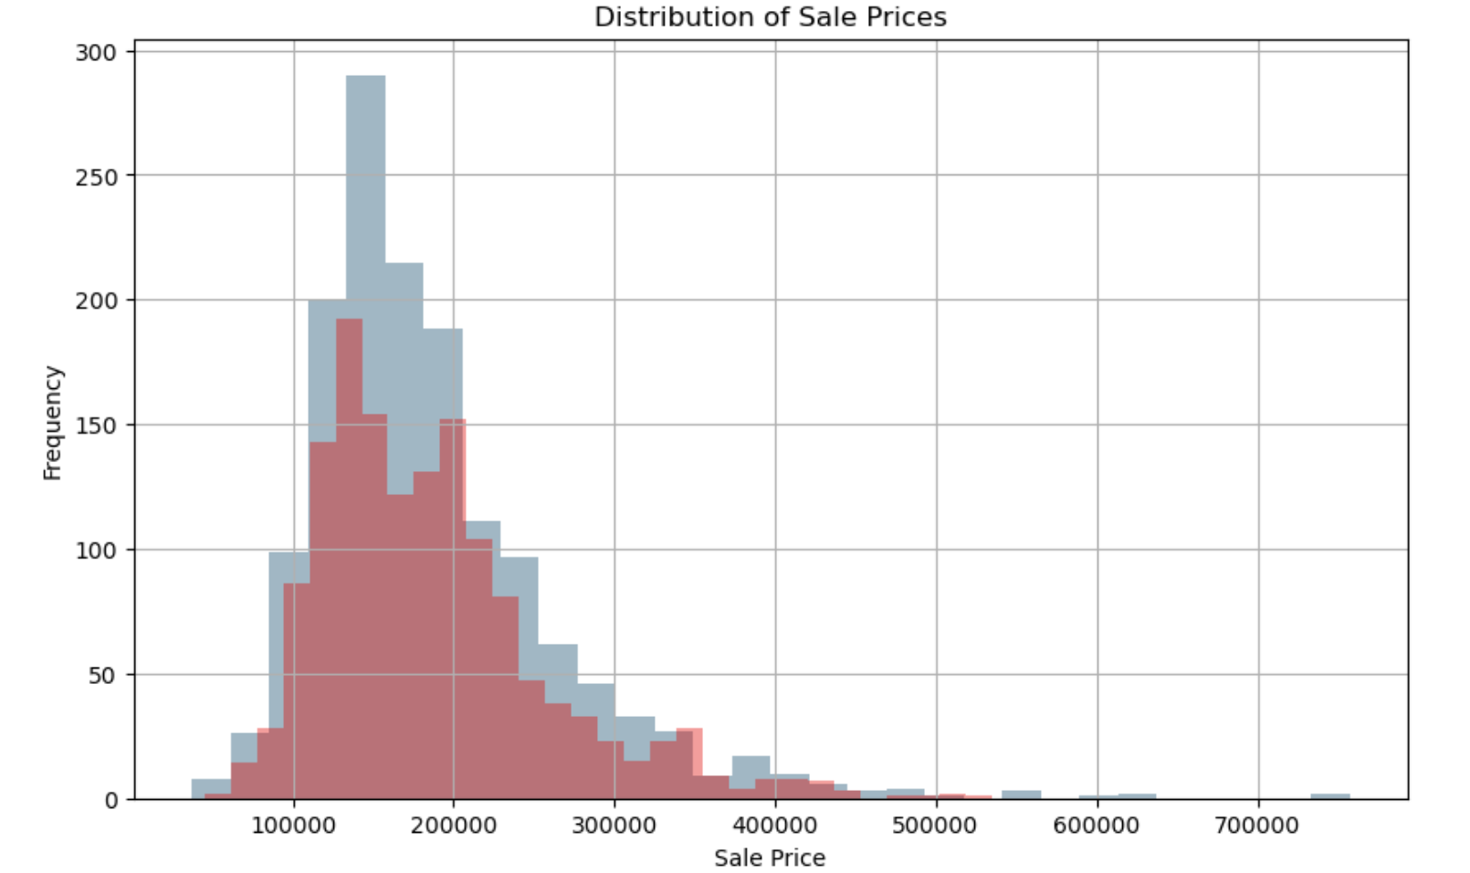
Prediction - Further Testing
Random Prediction: House ID 3
Predicted Price: $220,068.59
Actual Price: $228,892.00
Accuracy: 96.14%
Notes:
Arya
To further test the accuracy of our model, we decided to use the model to create a prediction on the original model and see how far off our model was compared to the original saleprice, so we ran the original data with our regression model and compared the distribution.
The original model in blue, and our prediction model in red. We can see that the model is quite accurate.
Furthermore, we picked a random house ID to see how far off our predicted price was compared to the actual SalePrice of the house, and it shows above that our model is 96.14% accurate in predicting the SalePrice of House ID 3.
This shows that our model is pretty accurate in predicting house prices, and our team is very confident and proud of our findings.
Thank you, now were open for any questions

